Slide 1
PHISHING ATTACK DETECTOR
CAPSTONE PROJECT
Presented By:
Ashwin Lourdes Immanuel.R- JEPPIAAR INSTITUTE OF TECHNOLOGY - AI & DS

Slide 2
OUTLINE
Problem Statement
Proposed System/Solution
System Development Approach
Algorithm & Deployment
Result
Conclusion
Future Scope
References

Slide 3
PROBLEM STATEMENT
Phishing attacks are a prevalent cybersecurity threat, aiming to deceive individuals into divulging sensitive information.
Traditional methods of detecting phishing attacks often rely on manual inspection and are prone to human error.
Automated detection systems are crucial for identifying and mitigating phishing attempts effectively.

Slide 4
PROPOSED SOLUTION
Our proposed solution is a phishing attack detection system leveraging machine learning algorithms.
By analyzing features extracted from phishing datasets, the system aims to identify suspicious patterns indicative of phishing behavior.
Real-time monitoring and automated response mechanisms enhance the system's ability to detect and respond to phishing attacks promptly.

Slide 5
SYSTEM DEVELOPMENT APPROACH
System Requirements:
The system requires access to the internet to fetch the phishing dataset from the ucimlrepo library.
A Python environment with necessary libraries such as pandas, numpy, scikit-learn, matplotlib, and seaborn is needed for data preprocessing, model training, evaluation, and visualization.
Libraries Required to Build the Model:
`ucimlrepo: Used to fetch the phishing dataset for model development.
pandas and numpy: Utilized for data manipulation and preprocessing tasks.
scikit-learn: Provides machine learning algorithms and tools for model training and evaluation.
matplotlib and seaborn: Used for data visualization, including plotting the confusion matrix.

Slide 6
ALGORITHM & DEPLOYMENT
Algorithm Selection:
The Decision Tree Classifier was selected for its interpretability and ability to handle both numerical and categorical data.
Decision trees offer a straightforward representation of decision rules, making them suitable for detecting patterns indicative of phishing behavior.
Data Input:
The phishing dataset obtained from the ucimlrepo library serves as the input data for training the model.
Features extracted from the dataset include URL characteristics, domain information, and webpage content attributes.

Slide 7
ALGORITHM & DEPLOYMENT
Training Process:
The dataset is split into training and testing sets using the train_test_split function, ensuring unbiased evaluation of the model.
The Decision Tree Classifier is trained on the training dataset, where it learns to classify instances as phishing or legitimate based on feature values.
Prediction Process:
Once trained, the model can make predictions on new instances to determine whether they are likely to be phishing attacks.
During the prediction process, the model evaluates the input features and classifies the instance as either phishing or legitimate based on learned decision rules.

Slide 8
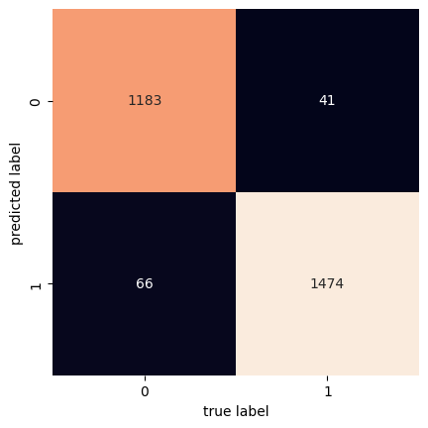
RESULT
The classification report provides insights into the precision, recall, and F1-score of the model for detecting phishing attacks.
An accuracy score of 96.0% was achieved, indicating the model's effectiveness in identifying phishing attempts.
The confusion matrix visualization illustrates the distribution of true positive, true negative, false positive, and false negative predictions.

Slide 9
CONCLUSION
Our phishing attack detection system demonstrates promising results in identifying and mitigating phishing attempts.
Machine learning algorithms offer a viable solution for automating the detection of phishing attacks and enhancing cybersecurity measures.
Continued research and development in this area are essential for staying ahead of evolving cyber threats and safeguarding sensitive information.

Slide 10
FUTURE SCOPE
Future enhancements may include exploring ensemble learning techniques and feature engineering to improve detection accuracy.
Collaboration with cybersecurity experts and industry partners can facilitate the integration of the detection system into existing security frameworks.
Continued monitoring and adaptation to emerging phishing techniques are necessary to ensure the system's effectiveness in mitigating cyber threats.

Slide 11
REFERENCES
Liu, S., Tseng, S., & Ma, J. (2011). Phishing websites detection based on host and webpage features. Journal of Network and Computer Applications, 34(4), 1079-1087.
Ramachandran, S., & Feamster, N. (2007). Understanding the network-level behavior of spammers. In Proceedings of the ACM SIGCOMM conference on Internet measurement (pp. 369-374).
Canali, D., Cova, M., & Vigna, G. (2011). Prophiler: A fast filter for the large-scale detection of malicious web pages. In Proceedings of the 20th USENIX conference on Security (pp. 15-15).
Ramanathan, A., & Shin, K. G. (2006). Detecting phishing attacks: A machine learning approach. In Proceedings of the 2006 ACM symposium on Information, computer and communications security (pp. 1-12).

Slide 12
THANK YOU

